Slide 1
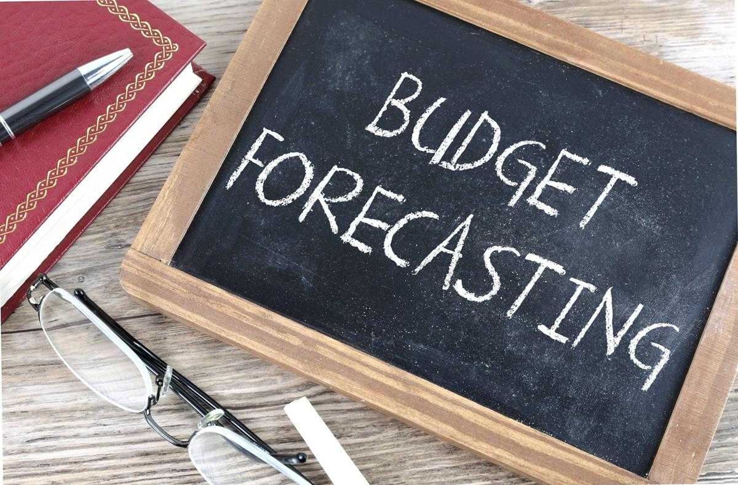
BUDGET FORECASTING FOR STARTUPS
This Photo by Unknown Author is licensed under CC BY-SA
BY
VRAJ ANILBHAI PATEL

Slide 2
BUDGET FORECASTING
MEANING
Budget forecasting is the process of estimating future financial performance
Based on past data, trends, and assumptions
Helps on past data, trends, and assumptions
Helps in planning income , expenses, and cash flow
IMPORTANCE
📊 Helps in better financial planning
💰 Ensures control over expenses
📈 Supports decision-making
⚠️ Reduces financial risks & uncertainty
🚀 Helps in achieving business growth

Slide 3
Why budget forecasting is Essential for startups
THE IMPORTANCE OF ACCURATE FINANCIAL PLANNING
Accurate financial planning is crucial for startup survival,
Influencing fundraising efforts, cash flow management,and
Strategic deicions. Remember,”90% of startups fail due to
Poor financial management.”

Slide 4
OBJECTIVES
Estimates future revenue CONTROL OVER EXPENSE
Help startups predict expected income Ensures proper allocation of financial resources
based on market trends and past data and also helps to avoid unnecessary spending
through which realistic target can be set and maintain cost efficiency
BETTER DECISION-MAKING RISK REDUCTION
Provides financial clarity for planning Investment Identifies possible financial risks in advance and
and operations Helps management to take helps in preparing backup plans for
informed and strategic decisions uncertainities

Slide 5
TYPES OF BUDGETS
OPERATING CASH CAPITAL SALES
BUDGET BUDGET BUDGET BUDGET
Shows day-to-day Tracks cash inflow used for planning Estimates expected
income and expense and outflow over long term sales revenue for a
of the business a period investments period

Slide 6
METHODS OF FORECASTING
Qualitative (expert opinion)
Quantitative (data analysis)
3. Trend analysis
4. Regression method

Slide 7
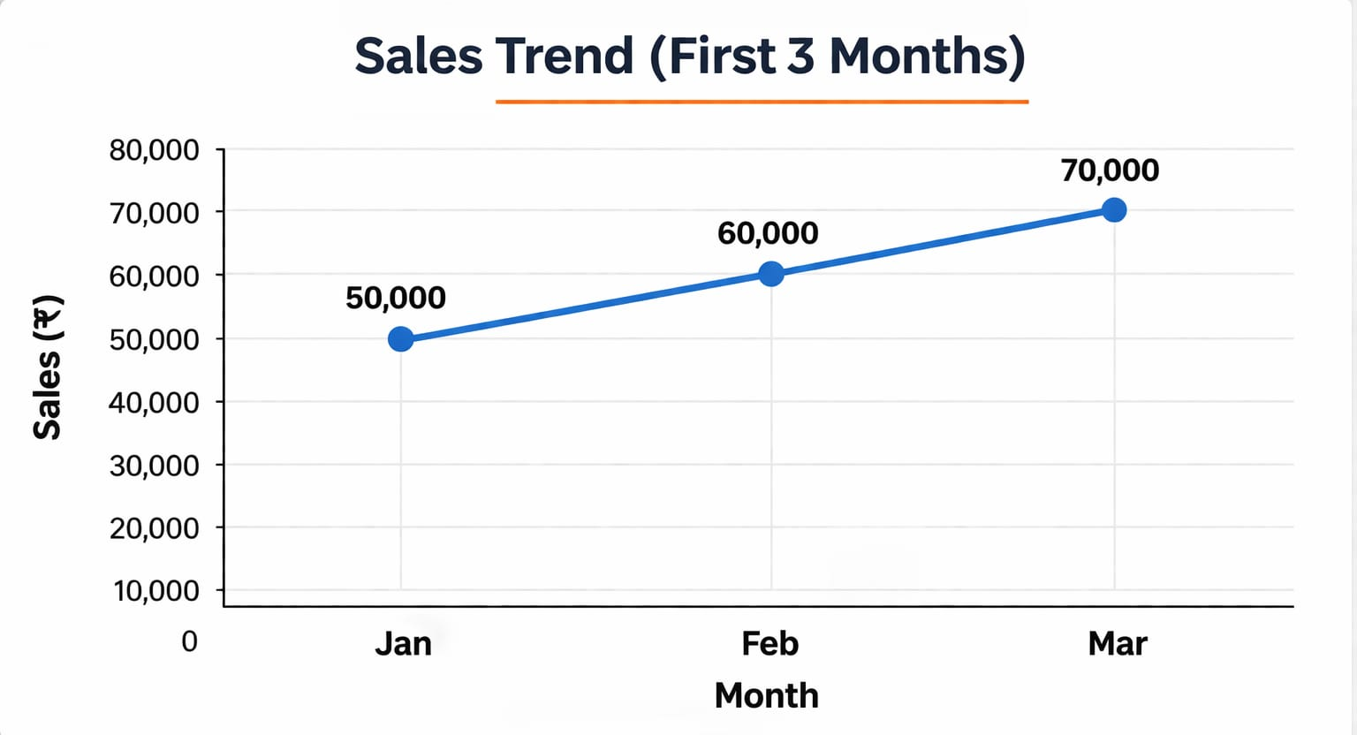
1. QUALITATIVE METHOD
Based on expert opinion and judgement
Used when no past data is available
Example: Market research and analysis
3. TREND ANALYSIS
Studies past trends & patterns
Assumes future will follow same trend
Simple & widely used
Example: sales trend ( Quantitative method)
2. QUANTITATIVE METHOD
Based on numerical data and swtatistics
Uses past data for future prediction
More accurate & objective
REGRESSION METHOD
Shows relationship between variables
Helps predict impact of one factor on another
Advanced & data-driven method
TREND ANALYSIS
Months | Sales(₹) | Expense(₹) | Profit(₹)
Jan | 50000 | 30000 | 20000
Feb | 60000 | 35000 | 25000
Mar | 70000 | 40000 | 30000

Slide 8
TOOLS AND DATA INPUTS
🛠️ Tools Used
Microsoft Excel – For calculations, tables, and charts
Google Sheets – For online data management and sharing
Financial Software – Helps in automated forecasting and reporting
Accounting Software – Helps in recording financial transactions
🛠️ Data Input
📂 Historical Data – Past sales, expenses, profits
🌍 Market Data – Industry trends and customer demand
🏢 Internal Data – Company costs and operations
💡 Assumptions – Growth rate, inflation, future expectations

Slide 9
Startups perspective in budget forecasting
💡 1. Focus on Short-Term Planning
Startups usually plan for monthly or quarterly budgets
Helps in quick adjustments due to changing market conditions
💰 2. Limited Financial Resources
Startups have restricted funds, so budgeting is very important
Ensures proper use of every rupee
📉 3. High Uncertainty & Risk
Market conditions are unpredictable for new businesses
Forecasting helps in preparing for possible osses
🔥 4. Monitoring Burn Rate
Burn rate means how fast a startup spends money
Helps in understanding how long the business can survive
📊 5. Flexible Budgeting Approach
Budgets should be adjusted frequently based on performance
Helps startups stay adaptable and responsive
⭐ 6. Investor Attraction
Proper forecasting builds confidence among investors
Shows financial planning and growth potential

Slide 10
ADVANTAGES OF BUDGET FORECASTING
BETTER FINANCIAL CONTROL
EFFICIENT RESOURCE ADVANTAGES GROWTH PLANNING
ALLOCATION
IMPROVED DECISION MAKING

Slide 11
STEPS IN BUDGET FORECASTING
1. Analyze past financial data
2. Estimate revenue
3. Forecast expenses
4. Prepare budget
5. Review regularly

Slide 12

Challenges in
Forecasting
Understanding the key difficulties startup face with budgeting
Startups often encounter significant obstacles in budget forecasting, such as unpredictable market costs,lack of historical data and cash flow instability, complicating their financial planning.

Slide 13

“A goal without a plan is just a wish”

Slide 14
CONCLUSION AND NEXT STEP
DEVELOP BUDGET
Start creating your first detailed budget forecast to guide your financial strategy.
REGULAR REVIEW
Schedule regular reviews and updates to keep your budget accurate and relevant.
CONTINUE LEARNING
Stay informed about budgeting best practices to enhance you financial decision-making skills.
CHOOSE TOOLS
Select appropriate tools and data sources to streamline your budgeting process.
ENGAGE TEAM
Involve your team in the process to ensure comprehensive insights and input.

Slide 15
THANK YOU

